Slide 1
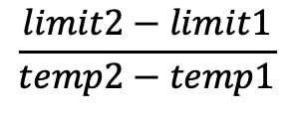
Hypothesis #1: Variability- Species and populations from more variable environments will have more plasticity
population
ARR
Calculate slope and standard error of slope
Compare slopes using weighted variance analysis
Variability
Acclimation Response Ratio (ARR)
$$\frac{limit2−limit1}{temp2−temp1}$$

